Slide 1
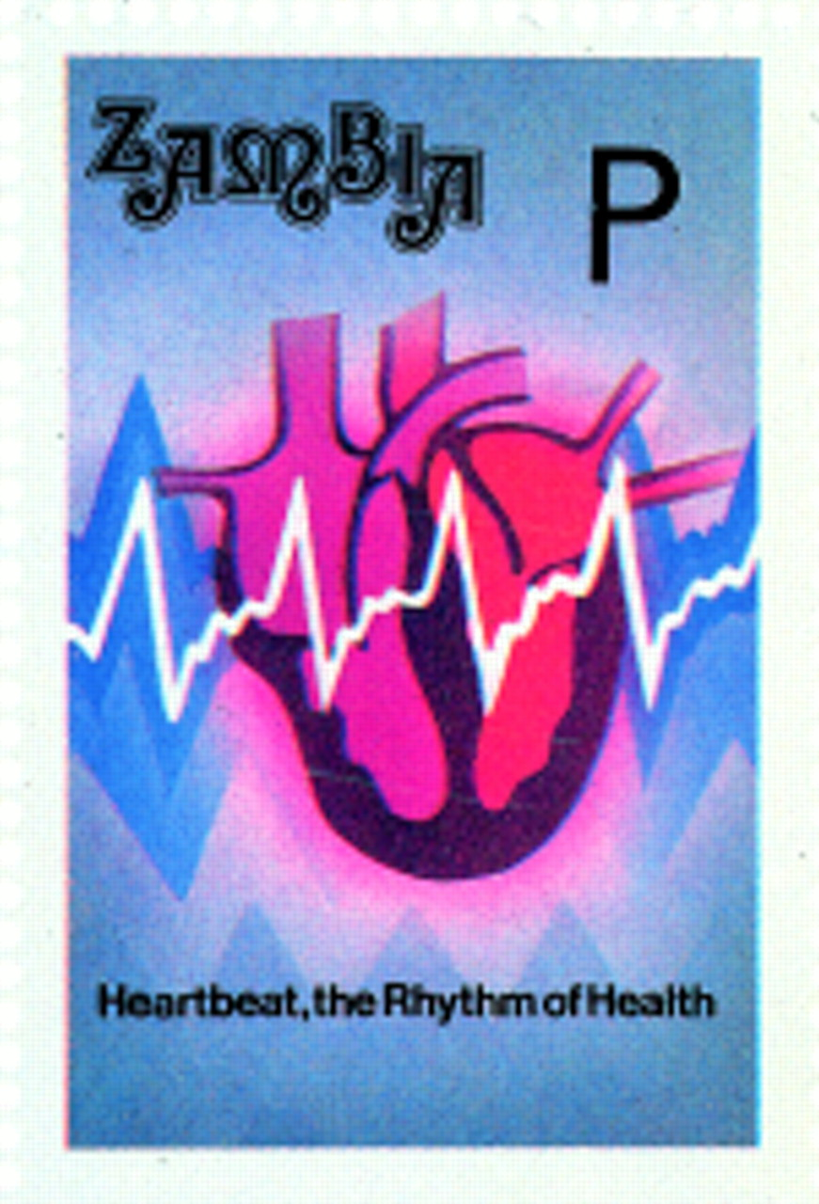

M K DAVIES, and A HOLLMAN Heart 1998;79:114
Copyright © BMJ Publishing Group Ltd & British Cardiovascular Society. All rights reserved.

Slide 2
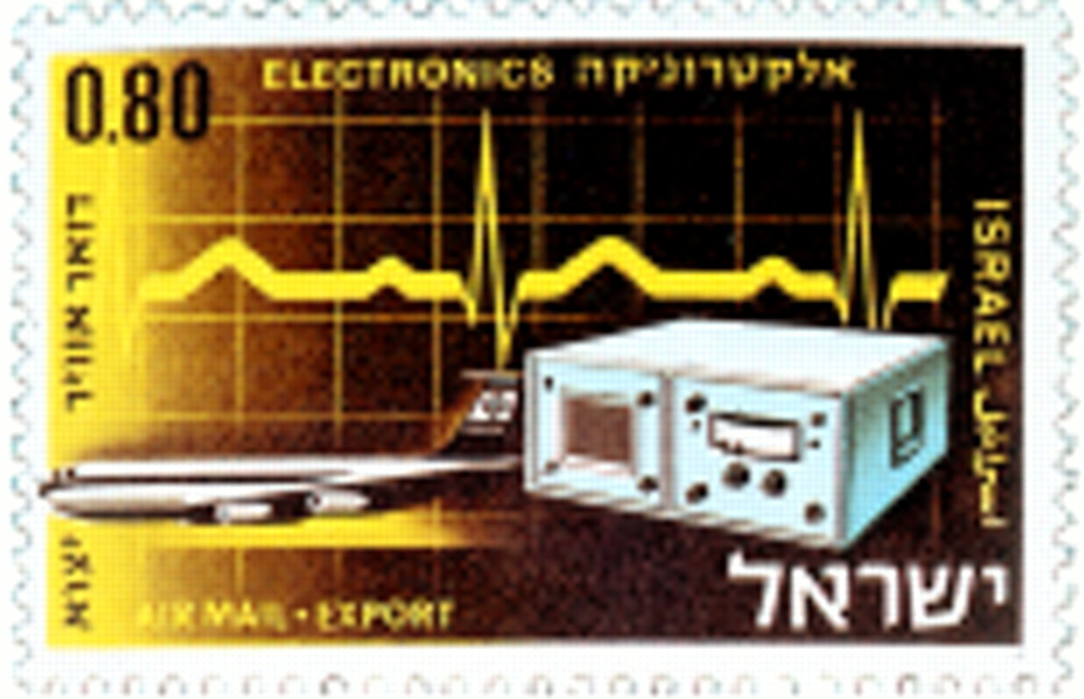
M K DAVIES, and A HOLLMAN Heart 1998;79:114
Copyright © BMJ Publishing Group Ltd & British Cardiovascular Society. All rights reserved.

Slide 3
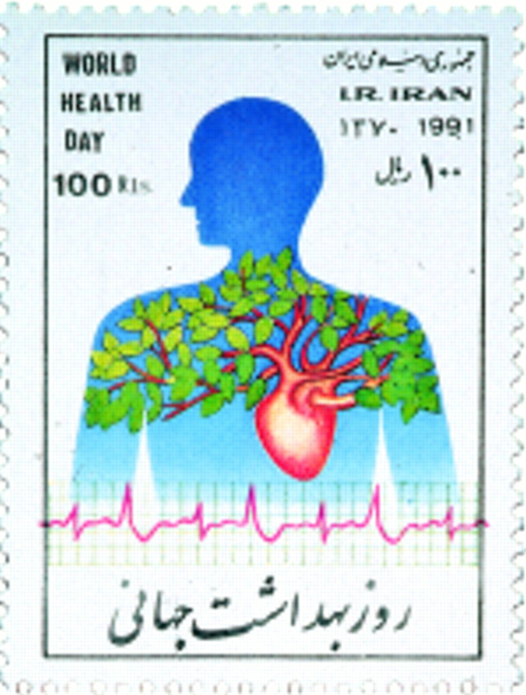
M K DAVIES, and A HOLLMAN Heart 1998;79:114
Copyright © BMJ Publishing Group Ltd & British Cardiovascular Society. All rights reserved.

