Slide 1
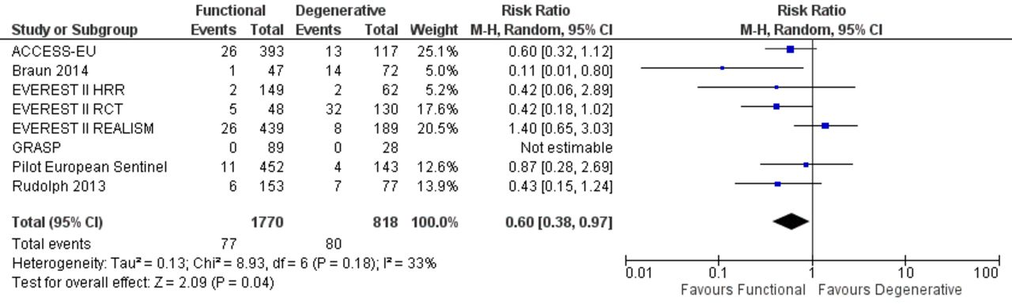

Risk estimates of MV re-intervention for functional mitral regurgitation versus degenerative mitral regurgitation.
Mauro Chiarito et al. Heart 2018;104:306-312
Copyright © BMJ Publishing Group Ltd & British Cardiovascular Society. All rights reserved.
Notes:
Risk estimates of MV re-intervention for functional mitral regurgitation versus degenerative mitral regurgitation. Forest plot shows results for MV re-intervention at 1 year. EVEREST II, Endovascular Valve Edge-to-Edge Repair Study II; MV, mitral valve.

