Slide 1
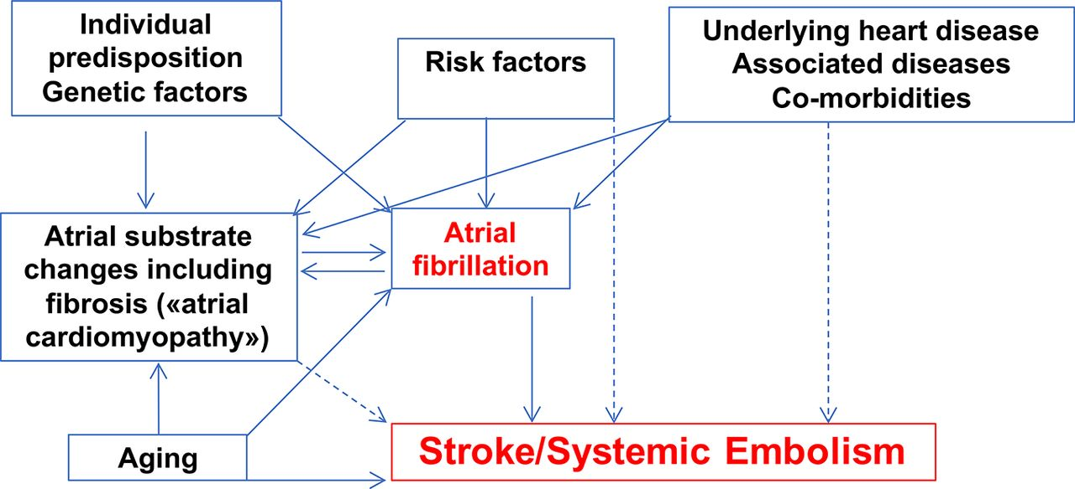

The complex interplay between risk factors, atrial and cardiac substrates, ageing and predisposing factors that is object of interventions for prevention of atrial fibrillation and of stroke/systemic embolism.
Catherine M Otto Heart 2018;104:872-874
Copyright © BMJ Publishing Group Ltd & British Cardiovascular Society. All rights reserved.
Notes:
The complex interplay between risk factors, atrial and cardiac substrates, ageing and predisposing factors that is object of interventions for prevention of atrial fibrillation and of stroke/systemic embolism.

